Slide 1
Demand Side Management for a Campus Infrastructure
BATCH : A6
TYPE : IN-HOUSE
GUIDE : DR. SG BHARATHI DASAN
TEAM MEMBERS
ASWIN NATESH. V (212712105023)
BADRI NARAYANAN. N (212712105025)
GANDHI RAJAN. R (212712105031)
MOHAMMED SAQIB. M (212712105061)

Slide 2
1st Review 2nd Review 3rd Review
01 Introduction to DSM
02 Need for DSM
03 DSM Techniques
04 Literature survey
05 Problem Formulation
01 Overview
02 Objective Load Curve
03 Methodology
04 Genetic Algorithm
05 Simulation & Results
01 Overview
02 Campus Data Analysis
03 Average Load Technique
04 Simulation Results
05 Case Study

Slide 3
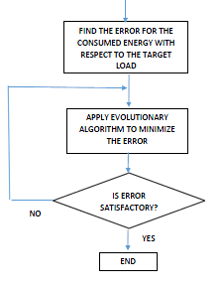
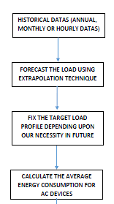
Block Diagram
Input Data to DSM Controller

Slide 4
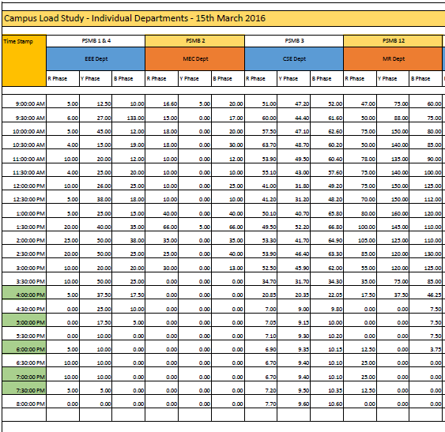
CAMPUS LOAD STUDY Period - ( 24 Hrs )
Mechanical
Electrical
Computer Science
Marine
ECE & Civil
Mechanical Workshop
Air Conditioners – Overall
Canteen
Hostel
Library & Admin Block
Lighting Loads – Classrooms

Slide 5
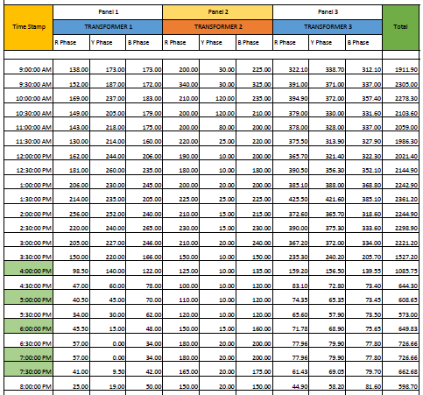
Distribution Transformer Data Period - ( 24 Hrs )

Slide 6
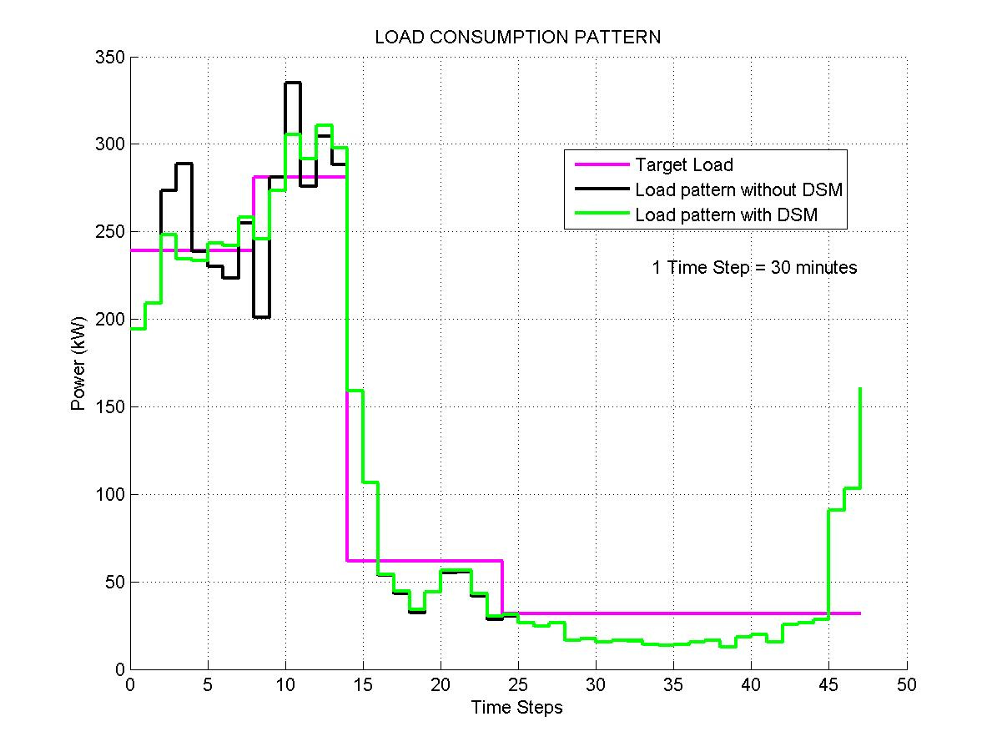
Without DC Grid

Slide 7
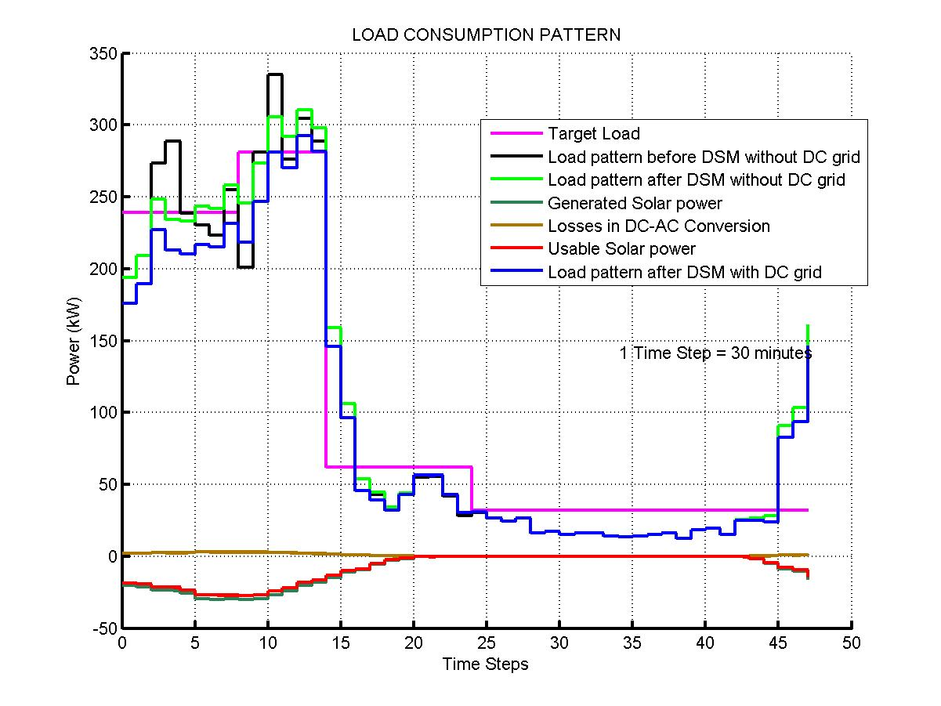
With DC Grid Existing 35KW Solar Power

Slide 8
Methodology

Slide 9
Parameters Involved
Device Type
Device Number
Delay parameter
Consumption period
Power rating of a particular device
Actual Start time
Operation time

Slide 10
VARYING PARAMETER
Variable in load shifting technique – DELAY
Assume Delay=4 hours
Power (in kW)
Time period
Power (in kW)
Start Time
Operation Time
1 2 3 4 5 6 7 8
Time (in hrs)
Time (in hrs)

Slide 11
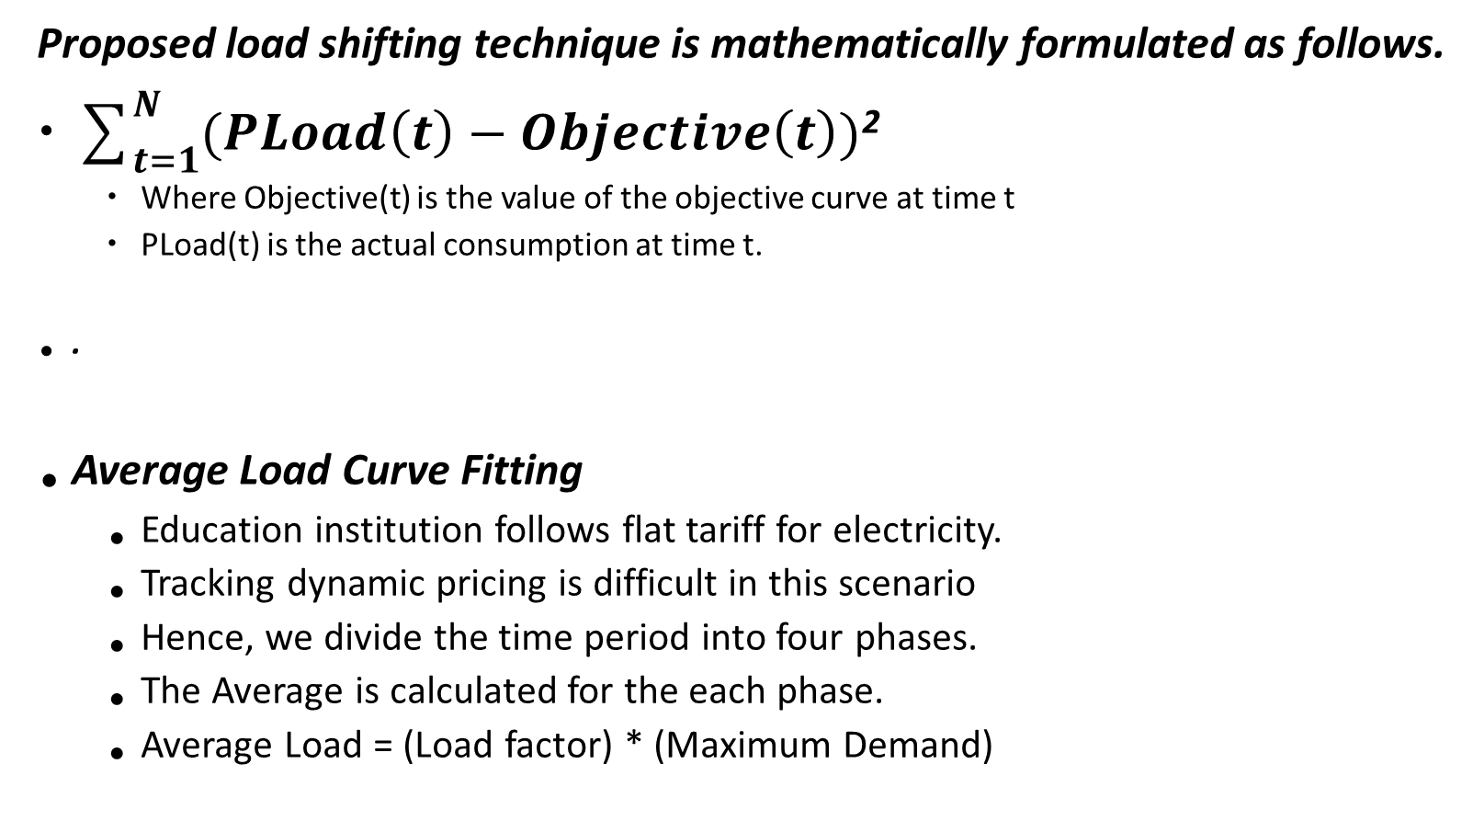
Proposed load shifting technique is mathematically formulated as follows.
$\sum_{t=1}^{N}{(PLoad\left(t\right)−Objective\left(t\right))}$²
Where Objective(t) is the value of the objective curve at time t
PLoad(t) is the actual consumption at time t.
.
^{Average Load Curve Fitting}
Education institution follows flat tariff for electricity.
Tracking dynamic pricing is difficult in this scenario
Hence, we divide the time period into four phases.
The Average is calculated for the each phase.
Average Load = (Load factor) * (Maximum Demand)

Slide 12
PLoad(t)=Forecast(t)+Connect(t)+Disconnect(t)
Where Forecast(t) is the forecasted consumption at time t ,and
Connect(t) and Disconnect(t) are the amount of loads to be connected and disconnected
at time t respectively during the load shifting.

Slide 13
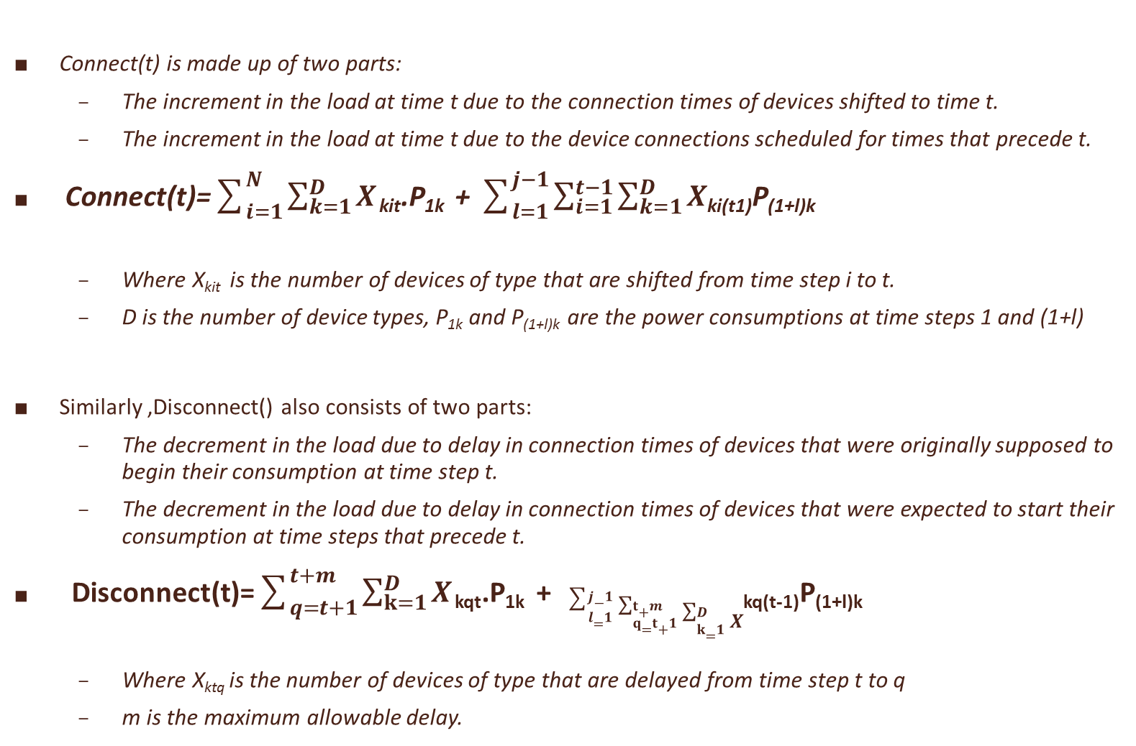
Connect(t) is made up of two parts:
The increment in the load at time t due to the connection times of devices shifted to time t.
The increment in the load at time t due to the device connections scheduled for times that precede t.
Connect(t)=$\sum_{i=1}^{N}{\sum_{k=1}^{D}{X}}$ _{kit}.P_{1k} + $\sum_{l=1}^{j−1}{\sum_{i=1}^{t−1}{\sum_{k=1}^{D}{X}}}$_{ki(t1)}P_{(1+l)k}
Where X_{kit} is the number of devices of type that are shifted from time step i to t.
D is the number of device types, P_{1k} and P_{(1+l)k} are the power consumptions at time steps 1 and (1+l)
Similarly ,Disconnect() also consists of two parts:
The decrement in the load due to delay in connection times of devices that were originally supposed to begin their consumption at time step t.
The decrement in the load due to delay in connection times of devices that were expected to start their consumption at time steps that precede t.
Disconnect(t)=$\sum_{q=t+1}^{t+m}{\sum_{k=1}^{D}{X}}$ _{kqt}.P_{1k} + $\sum_{l=1}^{j−1}{\sum_{q=t+1}^{t+m}{\sum_{k=1}^{D}{X}}}$_{kq(t-1)}P_{(1+l)k}
Where X_{ktq} is the number of devices of type that are delayed from time step t to q
m is the maximum allowable delay.

Slide 14
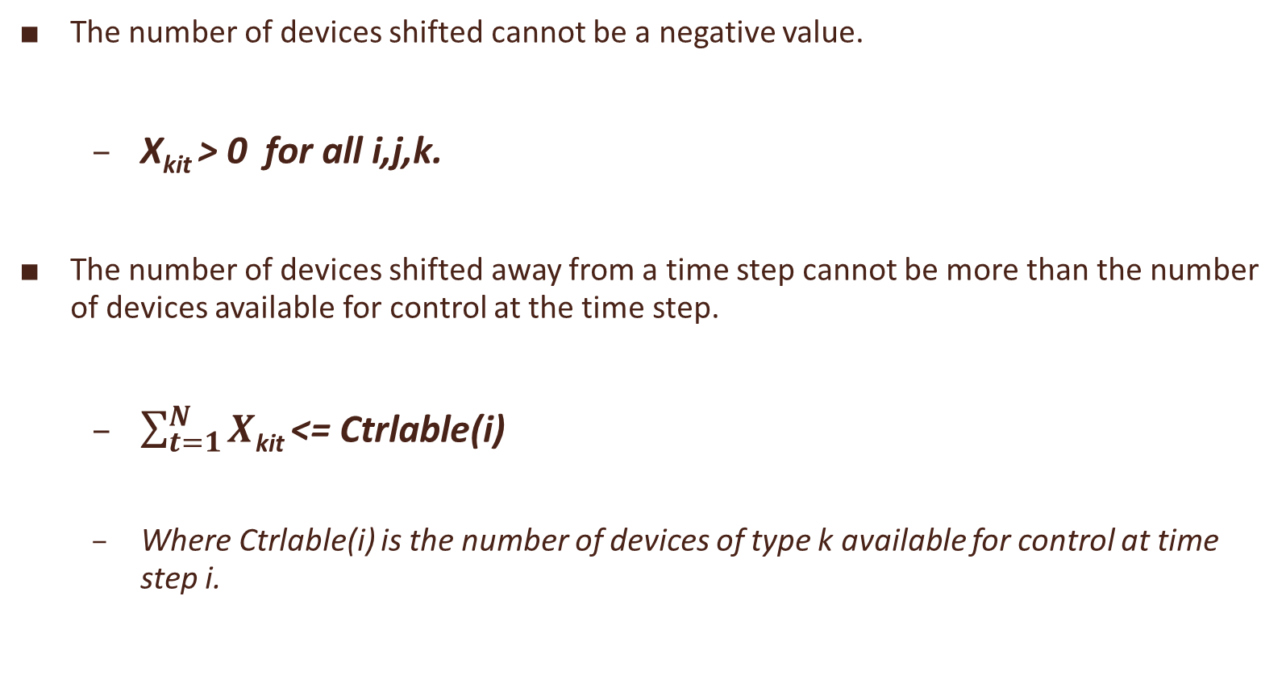
The number of devices shifted cannot be a negative value.
X_{kit} > 0 for all i,j,k.
The number of devices shifted away from a time step cannot be more than the number of devices available for control at the time step.
$\sum_{t=1}^{N}{X}$_{kit} <= Ctrlable(i)
Where Ctrlable(i) is the number of devices of type k available for control at time step i.

Slide 15
The Process Flow
In the genetic algorithm process is as follows:
Step 1. Determine the number of chromosomes, generation, and mutation rate and crossover rate value
Step 2. Generate chromosome-chromosome number of the population, and the initialization value of the genes chromosome-chromosome with a random value
Step 3. Process steps 4-7 until the number of generations is met
Step 4. Evaluation of fitness value of chromosomes by calculating objective function
Step 5. Chromosomes selection
Step 5. Crossover
Step 6. Mutation
Step 7. New Chromosomes (Offspring)
Step 8. Solution (Best Chromosomes)

Slide 16
Initialization
The most common type of genetic algorithm works as follows
A population is created with a group of individuals created randomly.
The random no generation is possible with rand() function.
The population is initialized keeping in account the constraints of the given problem.
Chromosome is initialized based on the constraints with the help of following logic
chromosome(I,j)=∑_(i=1)^n ∑_(j=1)^k (A(j)+(B(j)-A(j))*rand())
NOTE: rand() generates values between 0 and 1

Slide 17

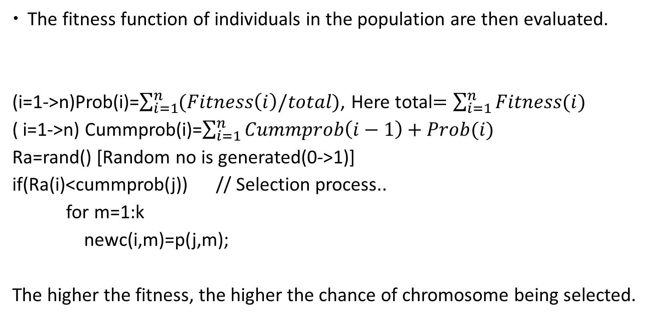
Evaluation and Selection…
The fitness function of individuals in the population are then evaluated.
(i=1->n)Prob(i)=$\sum_{i=1}^{n}{(Fitness\left(i\right)/total)}$, Here total$=\sum_{i=1}^{n}{Fitness(i)}$
( i=1->n) Cummprob(i)=$\sum_{i=1}^{n}{Cummprob\left(i−1\right)+Prob(i)}$
Ra=rand() [Random no is generated(0->1)]
if(Ra(i)<cummprob(j)) // Selection process..
for m=1:k
newc(i,m)=p(j,m);
The higher the fitness, the higher the chance of chromosome being selected.
n

Slide 18
Cross over
Three Steps involved in cross over
i).Parent Selection ii).N possibilities iii). Position for cross over
Step(i)
For k=1:n
R[k] ← random(0-1);
if (R[k] < ρc ) then
select Chromosome[k] as parent;
Step (ii):
For example: If three parents are selected then possibilities of crossover are,
Chromosome[1] >< Chromosome[4]
Chromosome[4] >< Chromosome[5]
Chromosome[5] >< Chromosome[1]
Step(iii)
m=floor((k-1)*rand()+1); (random no between 1 to (lengthofchromo-1)
for j=1:k
if(j<=m)
child(i,j)=parent(i,j);
else
child(i,j)=parent(i+1,j);
m points to position of crossover

Slide 19

Mutation
Total_gen(noe) = number_of_gen_in_Chromosome * number of population.
mut=pm*noe; where pm is the mutation rate.
totalmut=round(mut);
pos=floor((1+(noe-1)*rand(totalmut,1)));
The value of mutated gens at mutation point is replaced by random number.
for m=1:totalmut
if((i==row(m)) && (j==col(m)))
newc(i,j)=s(j)+(r(j)-s(j))*rand();
And after mutation process the next iteration starts and the process continues till we get the best chromosome…

Slide 20
Simulation & Results

Slide 21
Simulation & Results

Slide 22
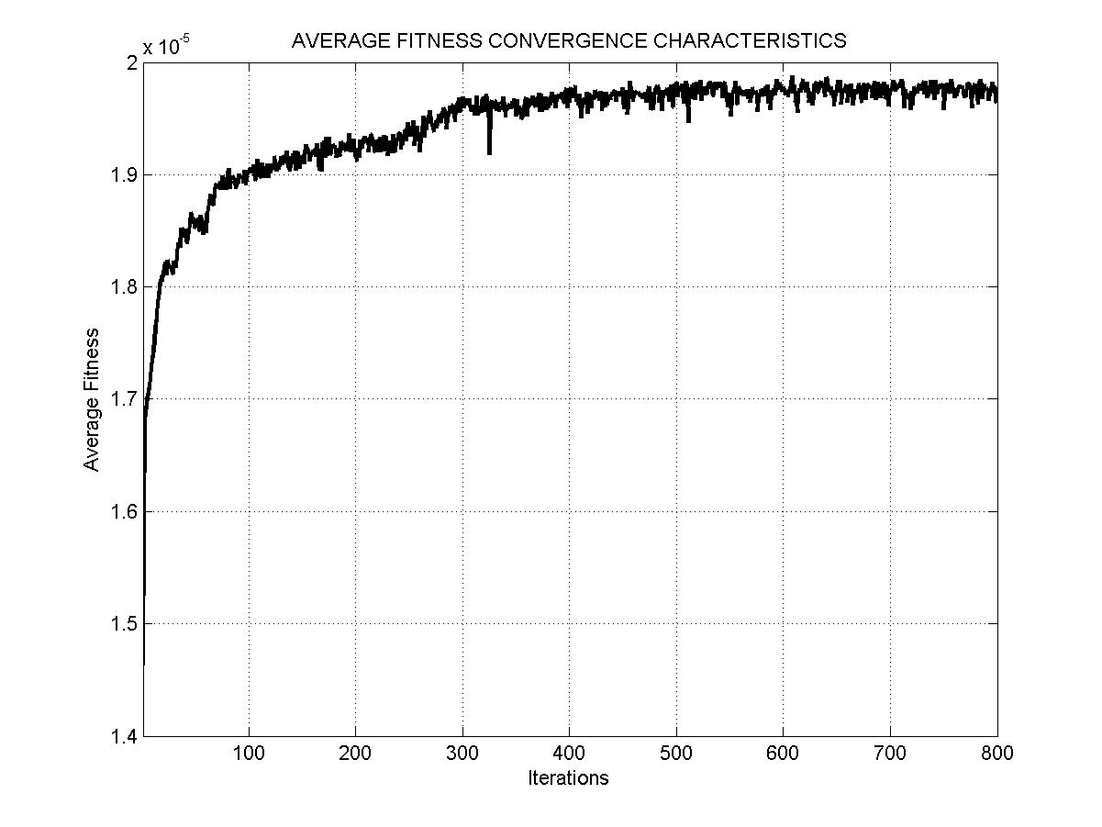
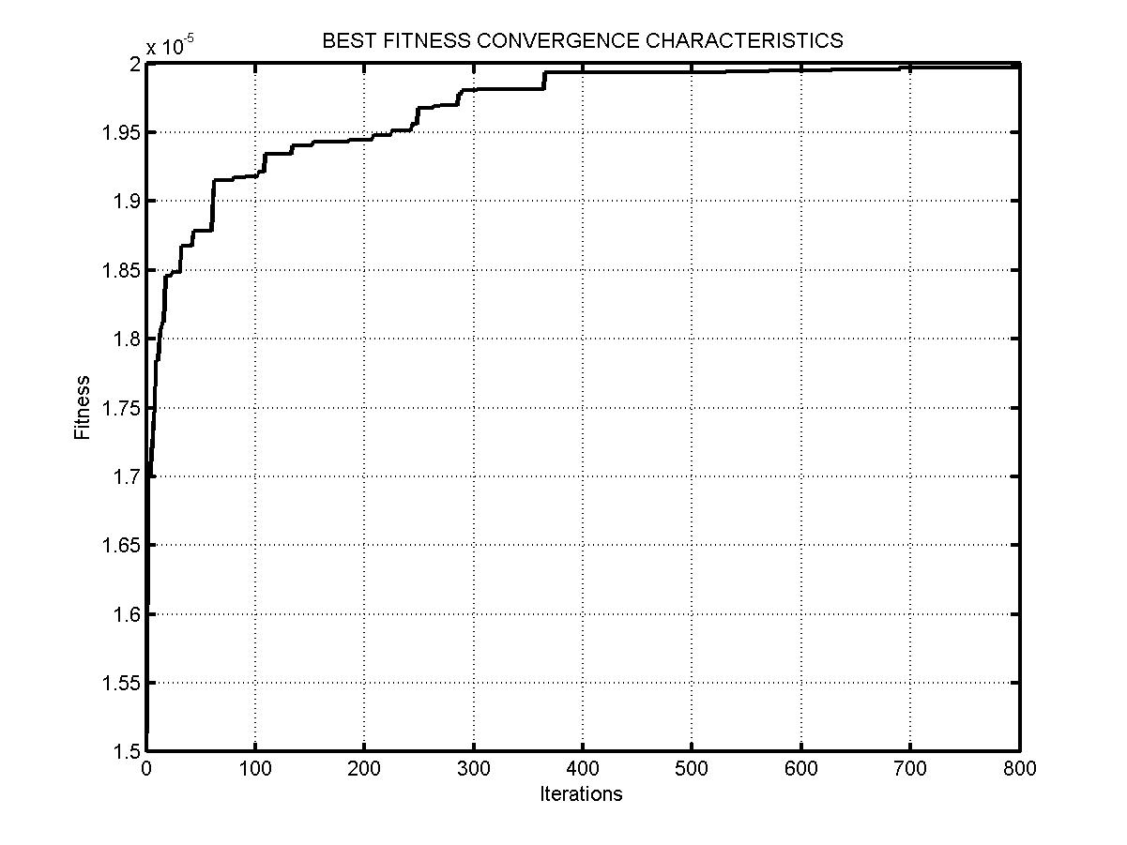
Simulation & Results

Slide 23
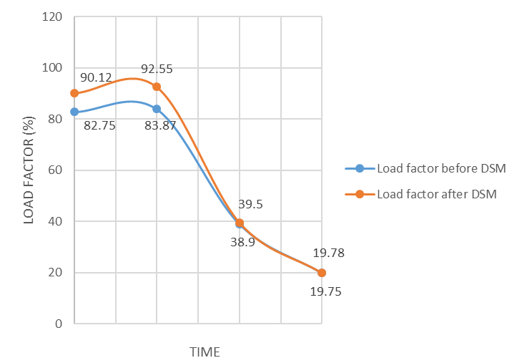
Simulation & Results
S No | Time | Load Factor before DSM (%) | Load Factor after DSM (%) | Peak reduction (%) | Over all Peak Reduction (%) | Overall Peak Reduction with DC Grid (%)
1 | 08:30 – 12:30 | 82.75 | 90.12 | 10.57 | 7.26 | 11.25
2 | 13:00 – 15:30 | 83.87 | 92.55 | 7.26
3 | 16:00 – 21:30 | 38.90 | 39.50 | 0
4 | 22:00 – 08:00 | 19.75 | 19.78 | 0
8:30-12:30 13:00-15:30 16:00-21:30 22:00-8:00

Slide 24
Case Study
The system considered for simulation is from Mumbai, the capital city of Maharashtra state in India.

Slide 25
Case Study
Time | Price | Hourly Forecasted Load (kW)
 |  | Residential |  | Industrial
08:00 – 09:00 | 12.00 | 729.4 |  | 2045.5
09:00 – 10:00 | 9.19 | 713.5 |  | 2435.1
10:00 – 11:00 | 12.27 | 713.5 |  | 2629.9
11:00 – 12:00 | 20.69 | 808.7 |  | 2727.3
12:00 – 13:00 | 26.82 | 824.5 |  | 2435.1
13:00 – 14:00 | 27.35 | 761.1 |  | 2678.6
14:00 – 15:00 | 13.81 | 745.2 |  | 2678.6
15:00 – 16:00 | 17.31 | 681.8 |  | 2629.9
16:00 – 17:00 | 16.42 | 667 |  | 2532.5
17:00 – 18:00 | 9.83 | 951.4 |  | 2094.2
18:00 – 19:00 | 8.63 | 1220.9 |  | 1704.5
19:00 – 20:00 | 8.87 | 1331.9 |  | 1509.7
20:00 – 21:00 | 8.35 | 1363.6 |  | 1363.6
21:00 – 22:00 | 16.44 | 1252.6 |  | 1314.9
22:00 – 23:00 | 16.19 | 1046.5 |  | 1120.1
23:00 – 00:00 | 8.87 | 761.1 |  | 1022.7
00:00 – 01:00 | 8.65 | 475.7 |  | 974
01:00 – 02:00 | 8.11 | 412.3 |  | 876.6
02:00 – 03:00 | 8.25 | 364.7 |  | 827.9
03:00 – 04:00 | 8.10 | 348.8 |  | 730.5
04:00 – 05:00 | 8.14 | 269.6 |  | 730.5
05:00 – 06:00 | 8.13 | 269.6 |  | 779.2
06:00 – 07:00 | 8.34 | 412.3 |  | 1120.1
07:00 – 08:00 | 9.35 | 539.1 |  | 1509.7

Slide 26
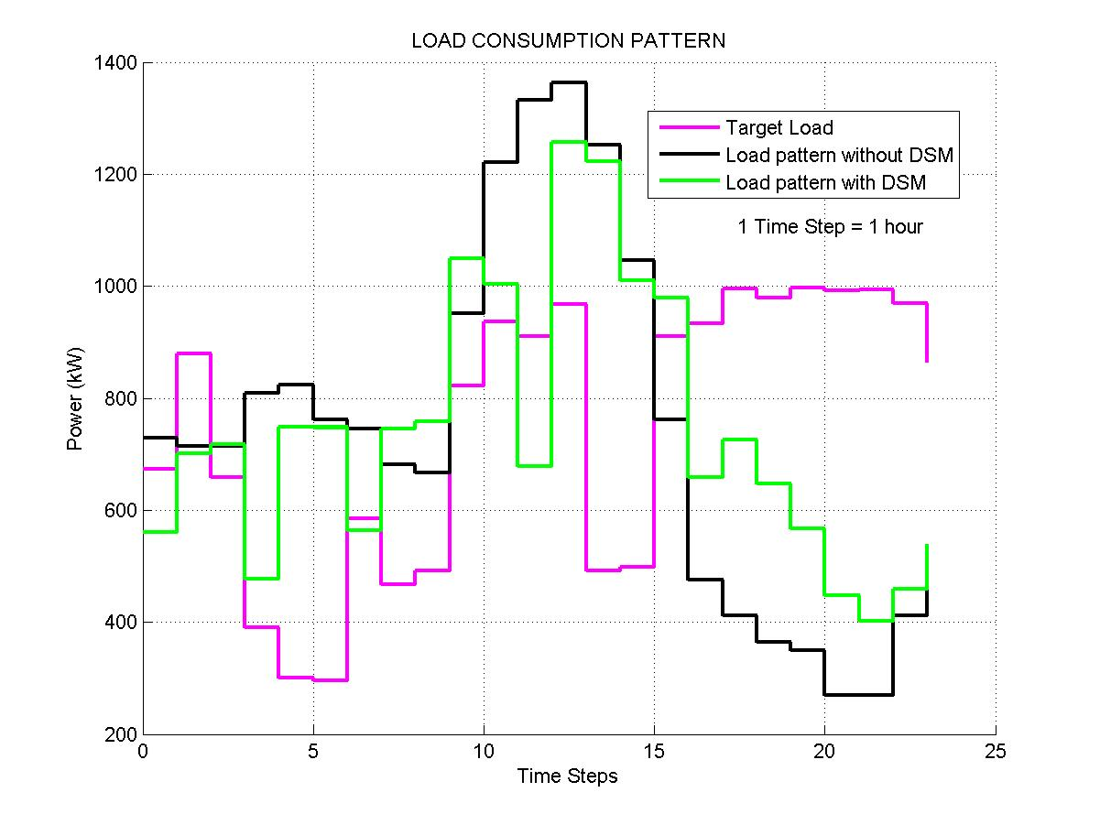
Case Study – Residential Area

Slide 27
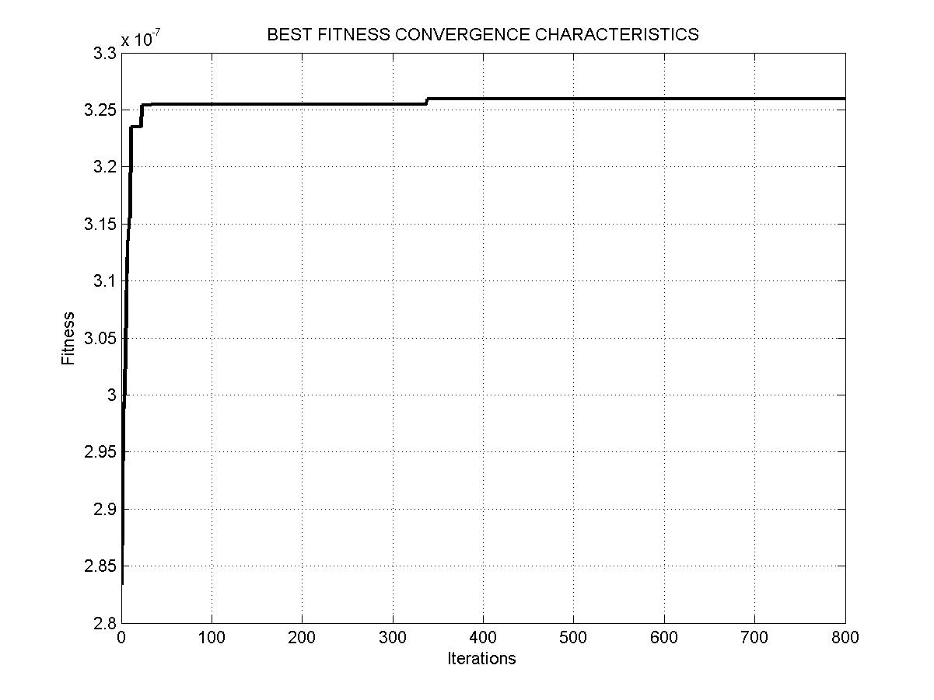
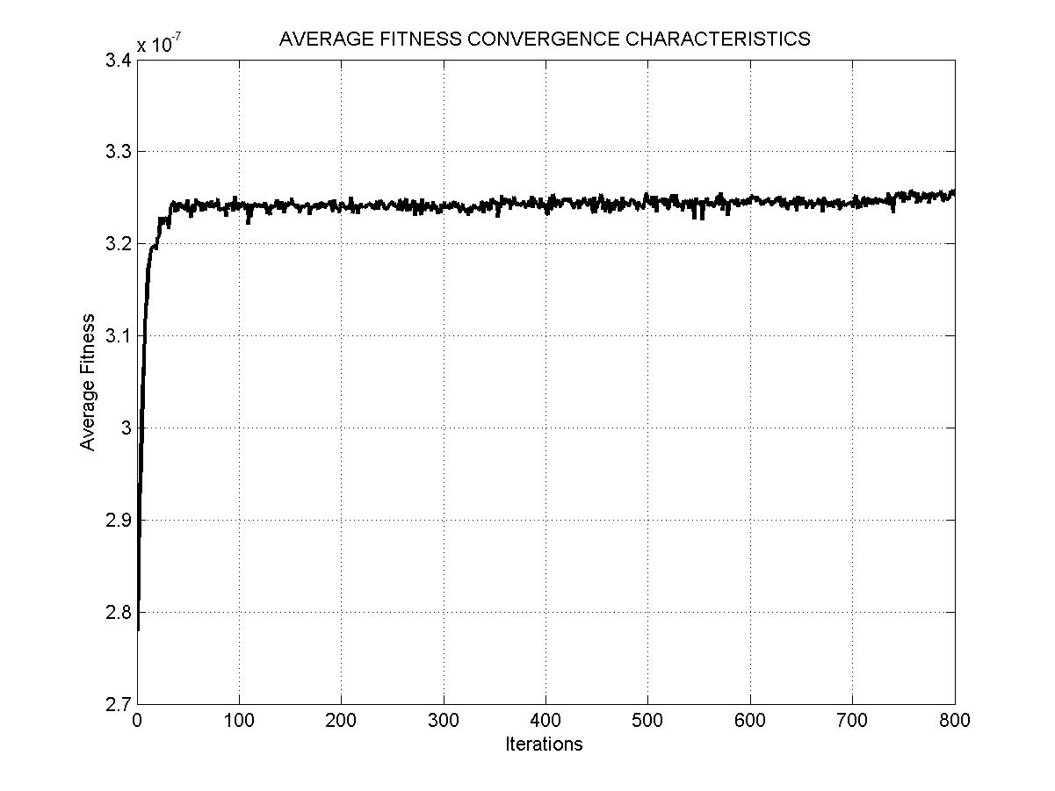
Residential Area – Convergence Characteristics

Slide 28
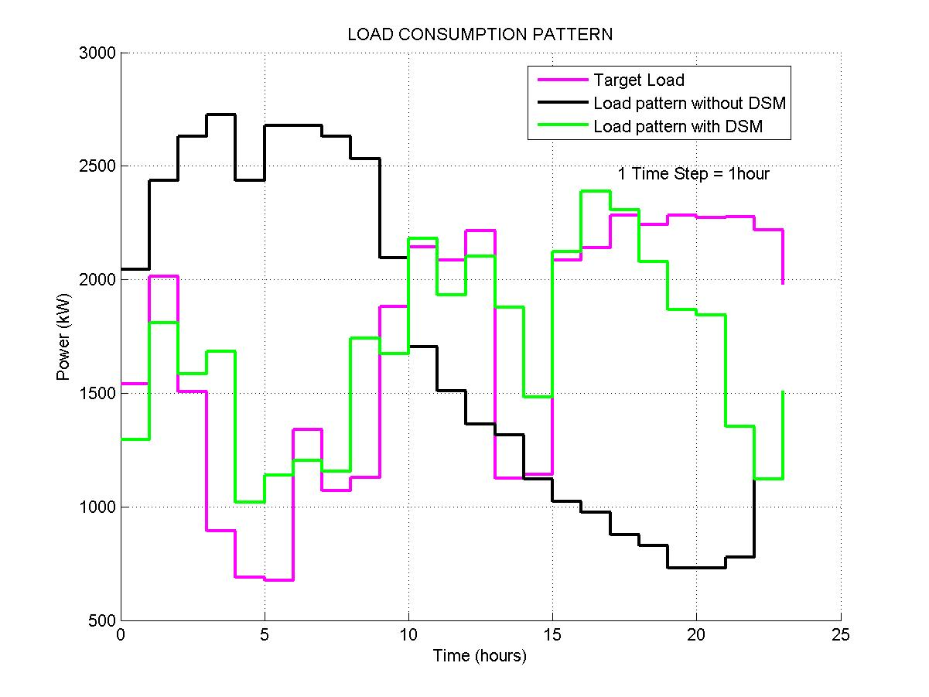
Case Study – Industrial Area

Slide 29
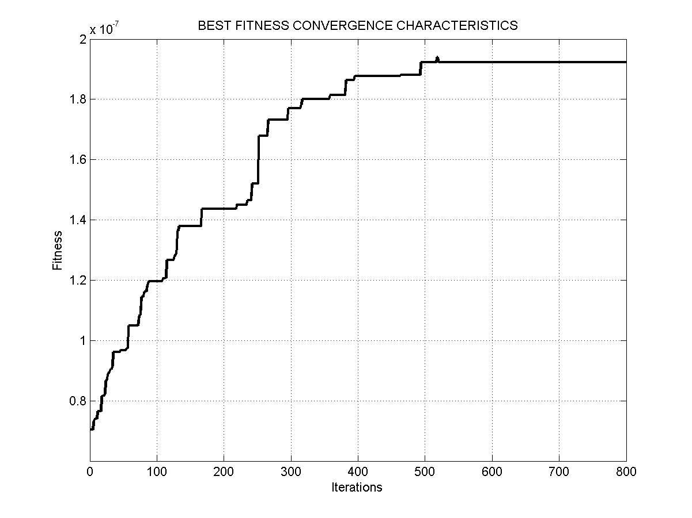
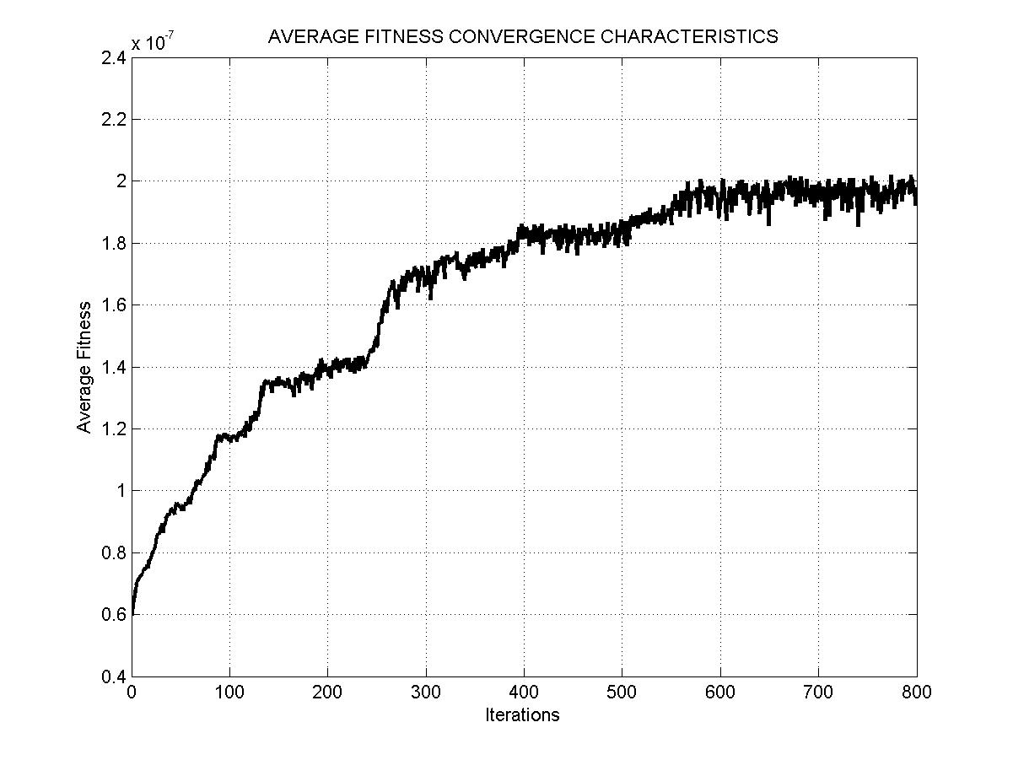
Industrial Area – Convergence Characteristics

Slide 30
Result & Conclusion
Cost Reduction with & without using DSM
 | Residential | Industrial
Peak Reduction (%) | 7.78 | 13.87
Cost without DSM (Rs) | 230,300 | 571,200
Cost with DSM (Rs) | 223,420 | 476,200
Cost Reduction (%) | 2.98 | 16.62

Slide 31
Contribution to the Society:
Smartness: Effectively managing loads in a power grid by adopting intelligent DSM Controllers.
Smart Pricing: Automatic metering that allows consumers to make informed decisions regarding their energy consumption, and peak load pricing.
Virtual Power Plant: Voluntarily lowering consumers demand for electricity
Carbon Footprint: Reduced greenhouse gas emissions.

Slide 32
References:
[1] Nandkishor Kinhekar and Narayana Prasad Padhy, “Utility Oriented Demand Side Management Using Smart AC and Micro DC Grid Cooperative”, Year: 2015, Volume: PP, Issue: 99 Pages: 1 – 10.
[2] Thillainathan Logenthiran and Dipti Srinivasan, “Demand Side Management in Smart Grid Using Heuristic Optimization”, Year: 2012, Volume: 3, Issue: 3 Pages: 1244 – 1252.
[1] Q. Li and M. Zhou, “The future-oriented grid-smart grid,” J. Comput.,vol. 6, no. 1, pp. 98–105, 2011.
[2] P. Agrawal, “Overview of DOE microgrid activities,” in Proc. Symp. Microgrid,Montreal,QC, Canada, 2006 [Online].Available: http://der.lbl.gov/2006microgrids_files/USA/Presentation_7_Part1_Poonumgrawal.pdf
[3] S. Rahman and Rinaldy, “An efficient load model for analyzing demand side management impacts,” IEEE Trans. Power Syst., vol. 8, no.3, pp. 1219–1226, Aug. 1993.
[4] A. I. Cohen and C. C. Wang, “An optimization method for load management scheduling,” IEEE Trans. Power Syst., vol. 3, no. 2, pp.612–618, May 1988.
[5] K.-H. Ng and G. B. Sheblé, “Direct load control-A profit-based load management using linear programming,” IEEE Trans. Power Syst., vol. 13, no. 2, pp. 688–694, May 1998.
[6] F. C. Schweppe, B. Daryanian, and R. D. Tabors, “Algorithms for a spot price responding residential load controller,” IEEE Trans. Power Syst., vol. 4, no. 2, pp. 507–516, May 1989.

Slide 33
Thank You !!

